Slide 1
Observer Design Pattern
Mehmet Aktaş

Slide 2
Observer Design Pattern
What is the Observer Pattern?
Motivation
Applicability
Structure and Participants
Collaborations
Consequences
Implementation

Slide 3
What is the Observer Pattern?
Define a one-to-many dependency between objects so that when one object changes state, all its dependents are notified and updated automatically.
Frequency of use: high

Slide 4
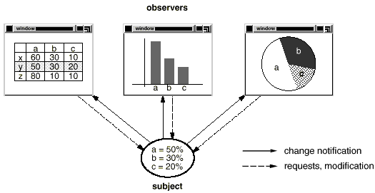
Motivation
Define a one-to-many dependency between objects so that when one object changes state, all its dependents are notified and updated automatically.
Encapsulate the core (or common or engine) components in a Subject abstraction, and the variable (or optional or user interface) components in an Observer hierarchy.
You don't want to achieve consistency by making the classes tightly coupled, because that reduces their reusability.
For example ;

Slide 5
Motivation(Cont.)
The Observer pattern describes how to establish these relationships. The key objects in this pattern are subject and observer. A subject may have any number of dependent observers. All observers,if they are subscribed, are notified whenever the subject undergoes a change in state
All observers are notified whenever the subject undergoes a change in state by subject. This kind of interaction is also known as publish-subscribe. Any number of observers can subscribe to receive notifications.

Slide 6
Applicability
Use the Observer pattern in following situations:
When a change to one object requires changing others, and you don't know how many objects need to be changed.
When an object should be able to notify other objects without making assumptions about who these objects are. In other words, you don't want these objects tightly coupled.

Slide 7
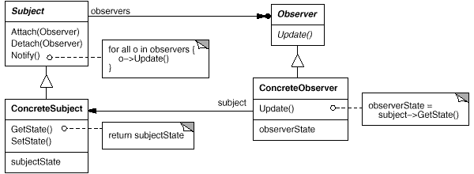
Structure

Slide 8
Participants
Subject
knows its observers. Any number of Observer objects may observe a subject.
provides an interface for attaching and detaching Observer objects.
Observer
defines an updating interface for objects that should be notified of changes in a subject.
ConcreteSubject
stores state of interest to ConcreteObserver objects.
sends a notification to its observers when its state changes.
ConcreteObserver
maintains a reference to a ConcreteSubject object.
stores state that should stay consistent with the subject's.
implements the Observer updating interface to keep its state consistent with the subject's.

Slide 9
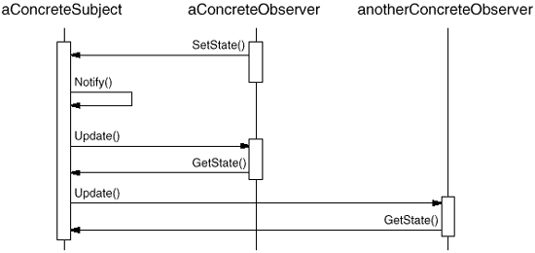
Collaborations
How it‘s works ;
ConcreteSubject notifies its observers whenever a change occurs that could make its observers' state inconsistent with its own.
After being informed of a change in the concrete subject, a ConcreteObserver object may query the subject for information. ConcreteObserver uses this information to reconcile its state with that of the subject.

Slide 10
Consequences
Abstract coupling between Subject and Observer : The subject doesn't know the concrete class of any observer. Thus the coupling between subjects and observers is abstract and minimal.
Support for broadcast communication : The notification is broadcast automatically to all interested objects that subscribed to it. The subject doesn't care how many interested objects exist; its only responsibility is to notify its observers.Freedom to add and remove observers at any time. It's up to the observer to handle or ignore a notification.
Unexpected updates : Because observers have no knowledge of each other's presence, they can be blind to the ultimate cost of changing the subject.
This updates may cause a cascade of updates to observers and their dependent objects. With additional protocol this problem can be removed.

Slide 11
Implementation
Live Demo
(Alarm Listener)
(Color Listeners)

Slide 12
References
Java Design Patterns - A Tutorial. James W. Cooper
http://sourcemaking.com/design_patterns/observer
http://www.blackwasp.co.uk/Observer.aspx
http://www.research.ibm.com/designpatterns/example.htm
http://en.wikipedia.org/wiki/Observer_pattern#Java

Slide 13
Thanks!

